Slide 1
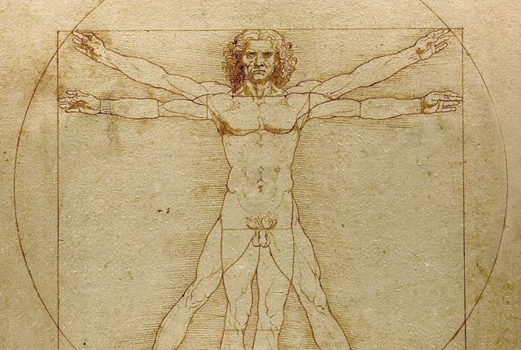
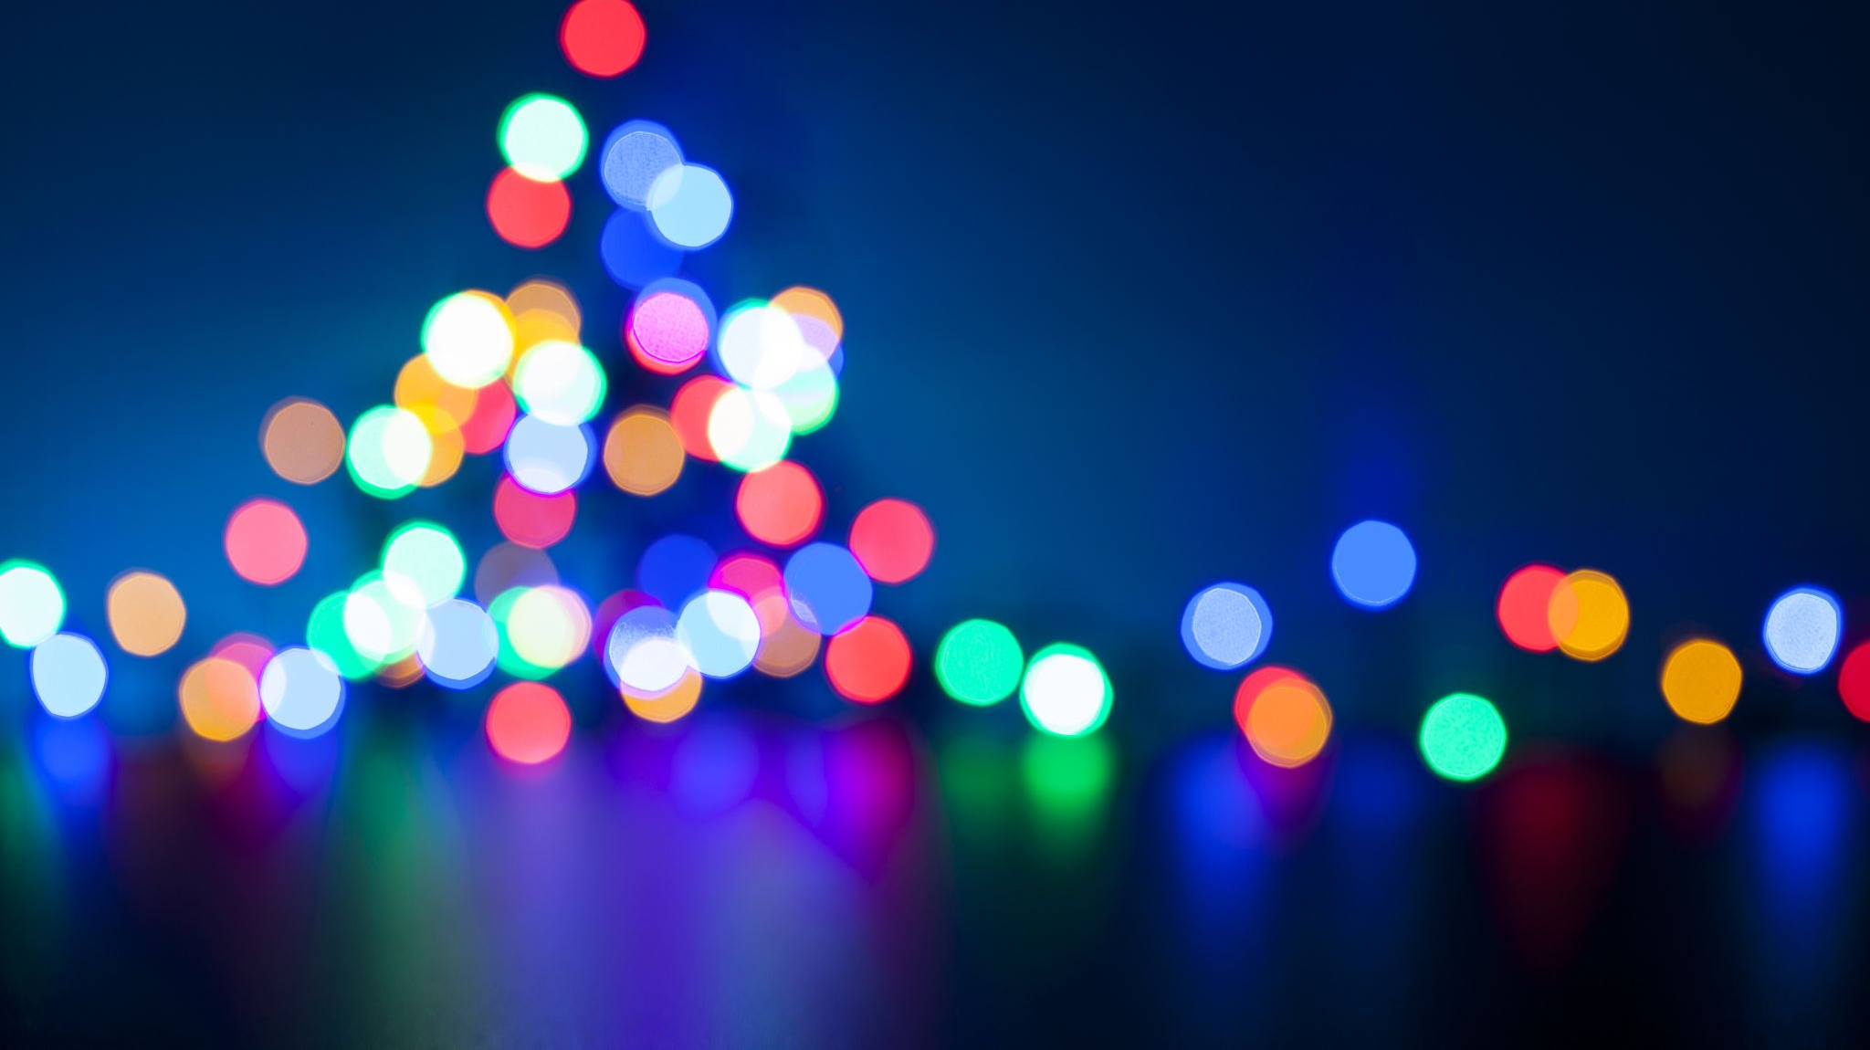
Da Vinci Code
Group 9

Slide 2
Group Members
Hasnain Raza
Alex Szabo
Emilio Tomaselli
Keilan Johnson

Slide 3
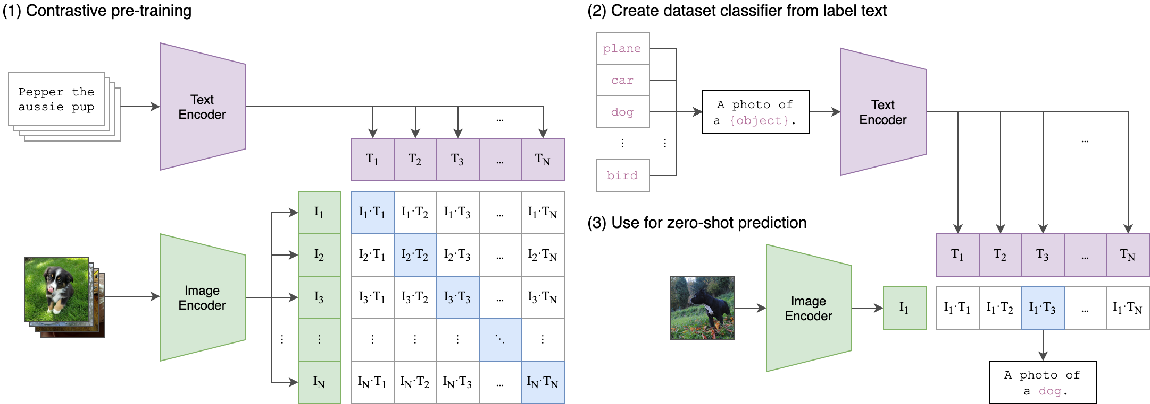
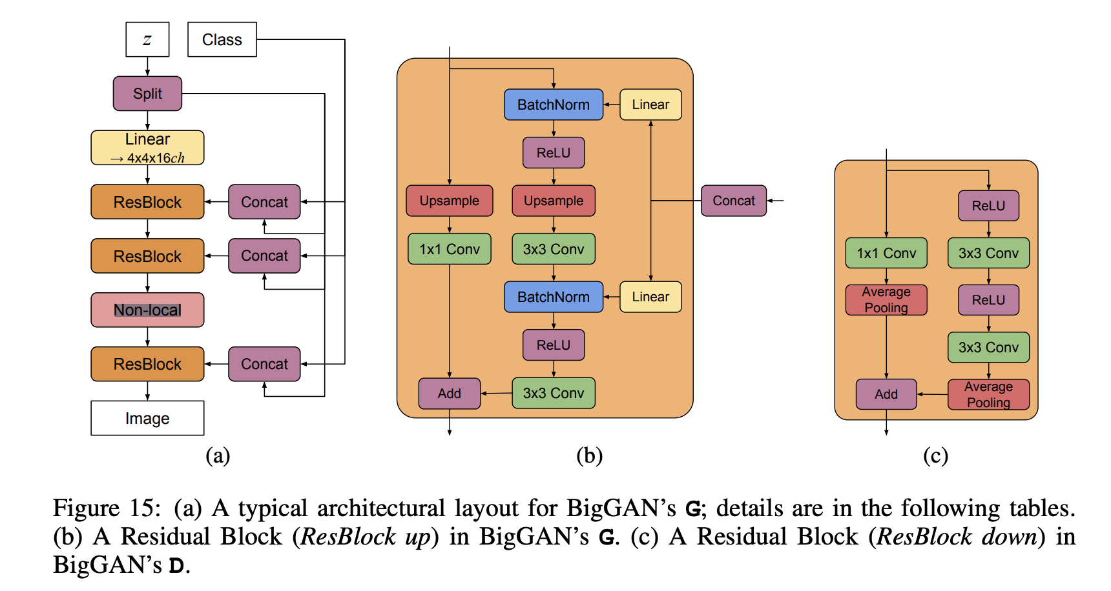
Big sleep - Model
CLIP
BigGAN

Slide 4
DA VINCI CODE APP SET UP
Created Flask application with easy-to-use User Interface.
Hosted on Google Colab as Big Sleep model requires an Nvidia GPU to run.
User Inputs text to generate image.
Once generated, the image can be downloaded for the user to minted to an NFT.

